Slide 1
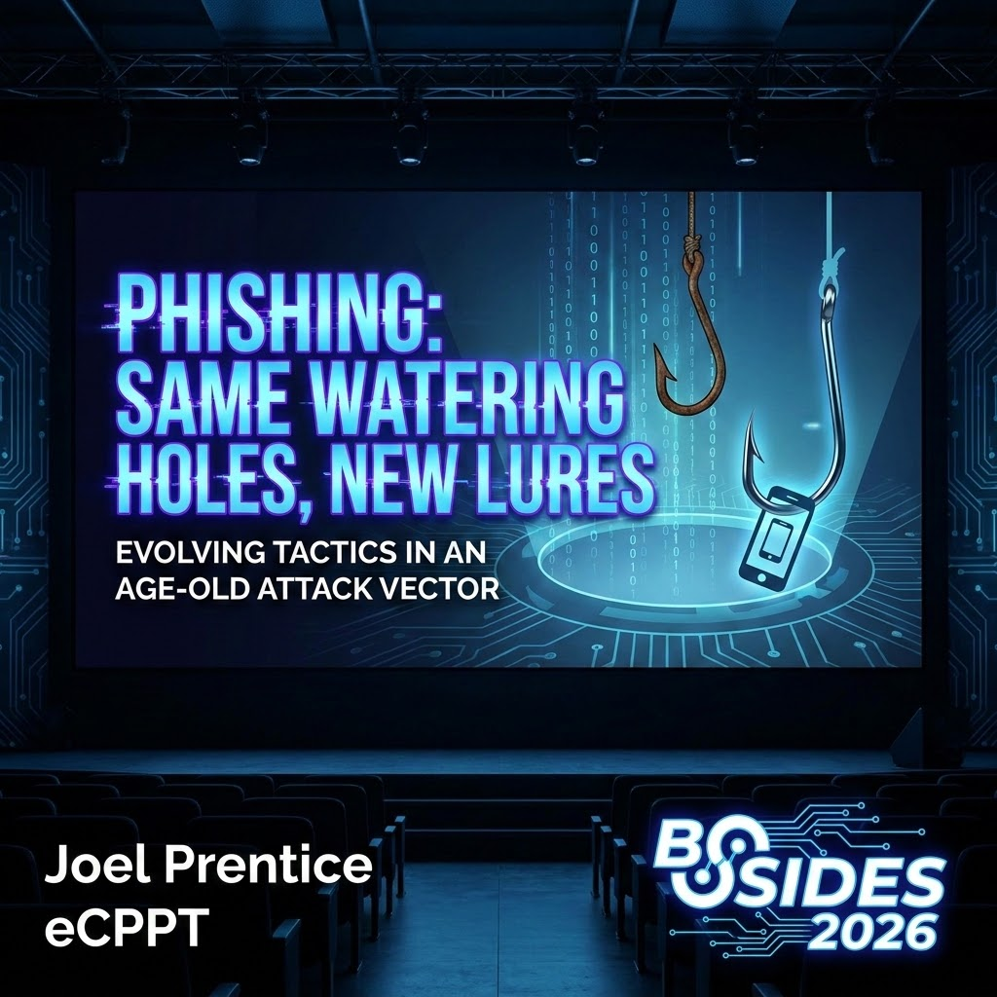
Notes:
The Hook: Start with a bold claim: "In 2026, traditional MFA is no longer a 'security' feature—it’s a speed bump."
Context: Mention that Microsoft’s recent Digital Defense Report shows 40,000 AiTM incidents daily.
The Shift: Explain that we are moving from "Credential Harvesting" (stealing passwords) to "Session Hijacking" (stealing the keys to the kingdom).

Slide 2
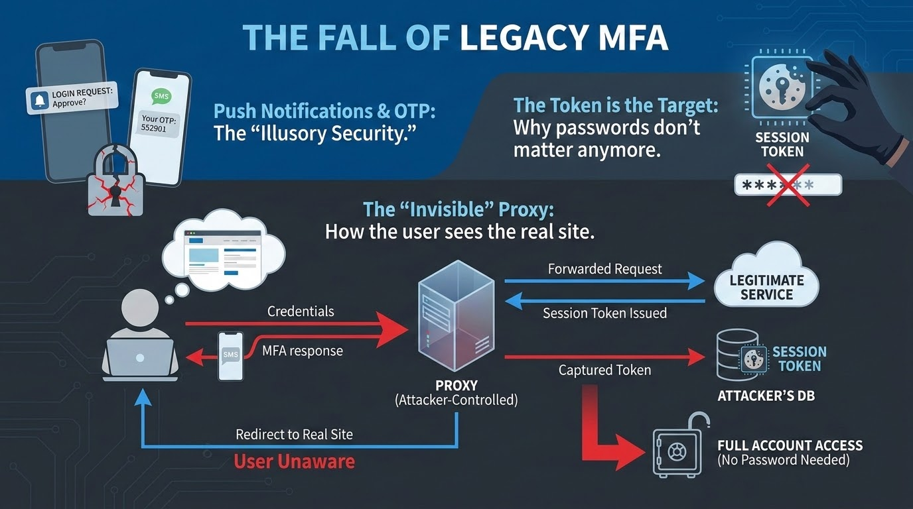
Notes:
The Reality Check: Explain that attackers don't care about your 16-character password if they can just walk through the door you already unlocked.
Mechanism: Briefly describe the transparent proxy. The user isn't looking at a "fake" site; they are looking at the real Microsoft/Okta/Google login page through a window controlled by the attacker.
The Vulnerability: The core issue isn't a "bug" in MFA; it’s a design feature of the web—the session cookie. Once that cookie is issued, it's a single-factor token.

Slide 3
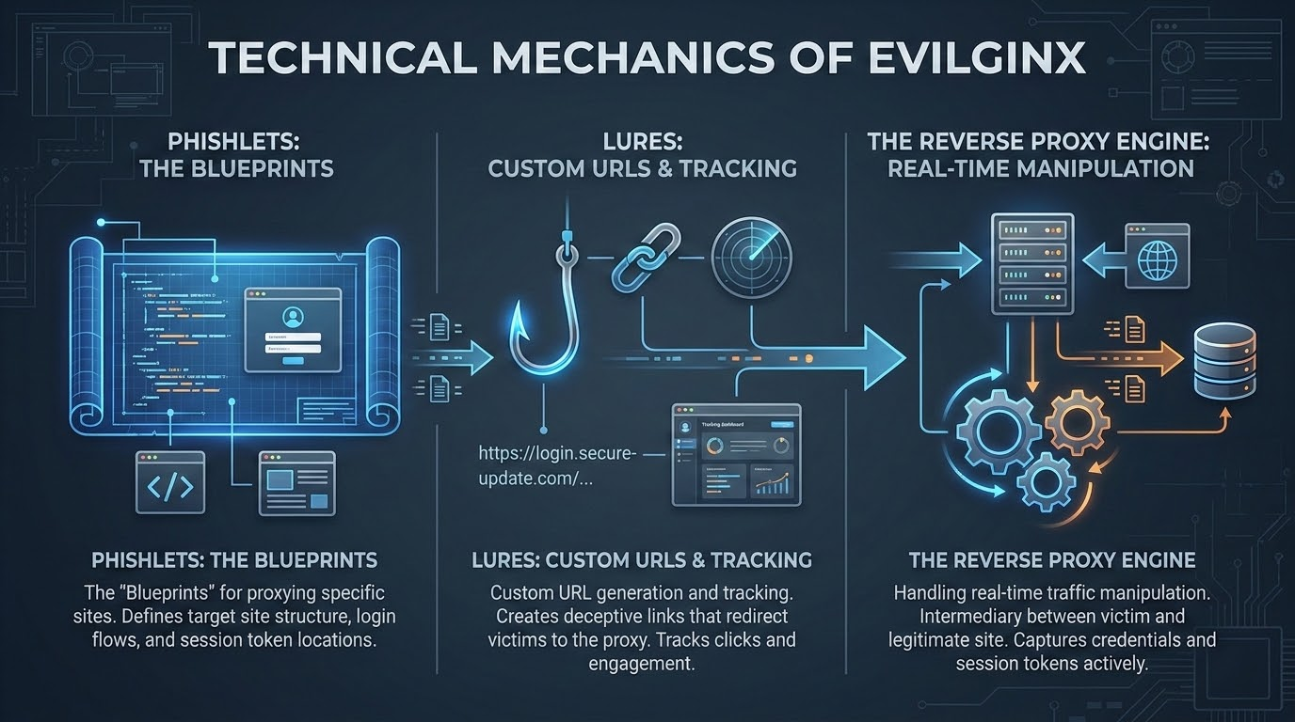
Notes:
Phishlets Deep Dive: Explain how phishlets work. They are YAML files that tell Evilginx exactly which cookies to capture and which URLs to proxy.
Real-time Injection: Discuss how Evilginx can inject custom JavaScript into the legitimate page to hide security warnings or modify the UI.
Stealth: Mention how Evilginx handles certificates (TLS) and how it can automatically generate valid Let's Encrypt certificates to get the "green padlock."

Slide 4
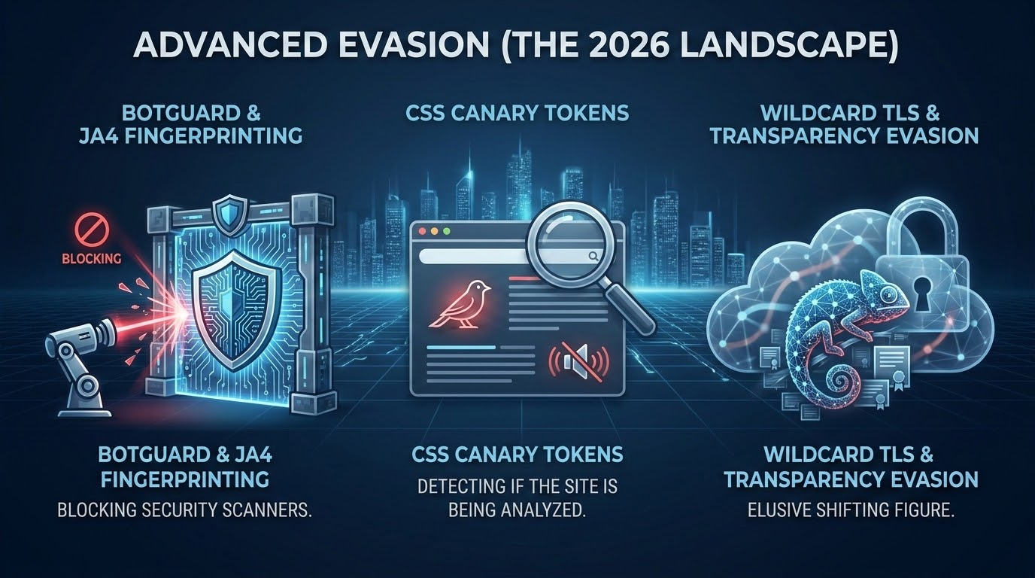
Notes:
Anti-Analysis: Attackers now use "Botguard" (pioneered in Evilginx Pro) to fingerprint browsers. If a request looks like a security scanner or an automated sandbox, Evilginx serves a "decoy" site (like a harmless blog) while serving the real lure to the victim.
Wildcard Bypass: Explain how using wildcard certificates prevents the specific phishing subdomain from appearing in public Certificate Transparency logs, keeping the "lure" hidden from threat hunters for longer.

Slide 5
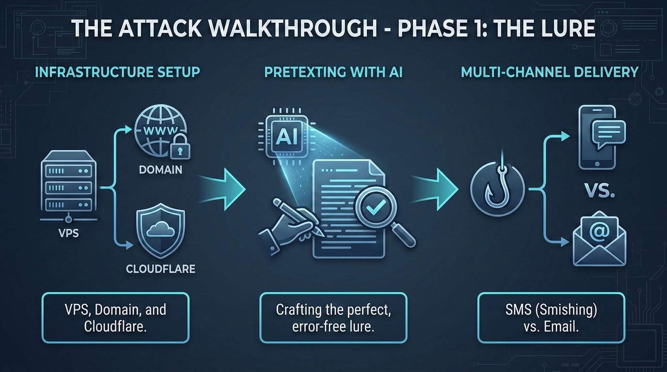
Notes:
Speed to Market: In 2026, an attacker can spin up a fully functional Evilginx instance in under 10 minutes.
AI-Enhanced Lures: Mention how LLMs are used to generate perfectly formatted corporate emails that match the target company's tone and brand guidelines.
The QR Code Lure: Briefly discuss the rise of "Quishing"—using QR codes in emails to force users onto mobile devices, which often have weaker visibility and security controls.

Slide 6
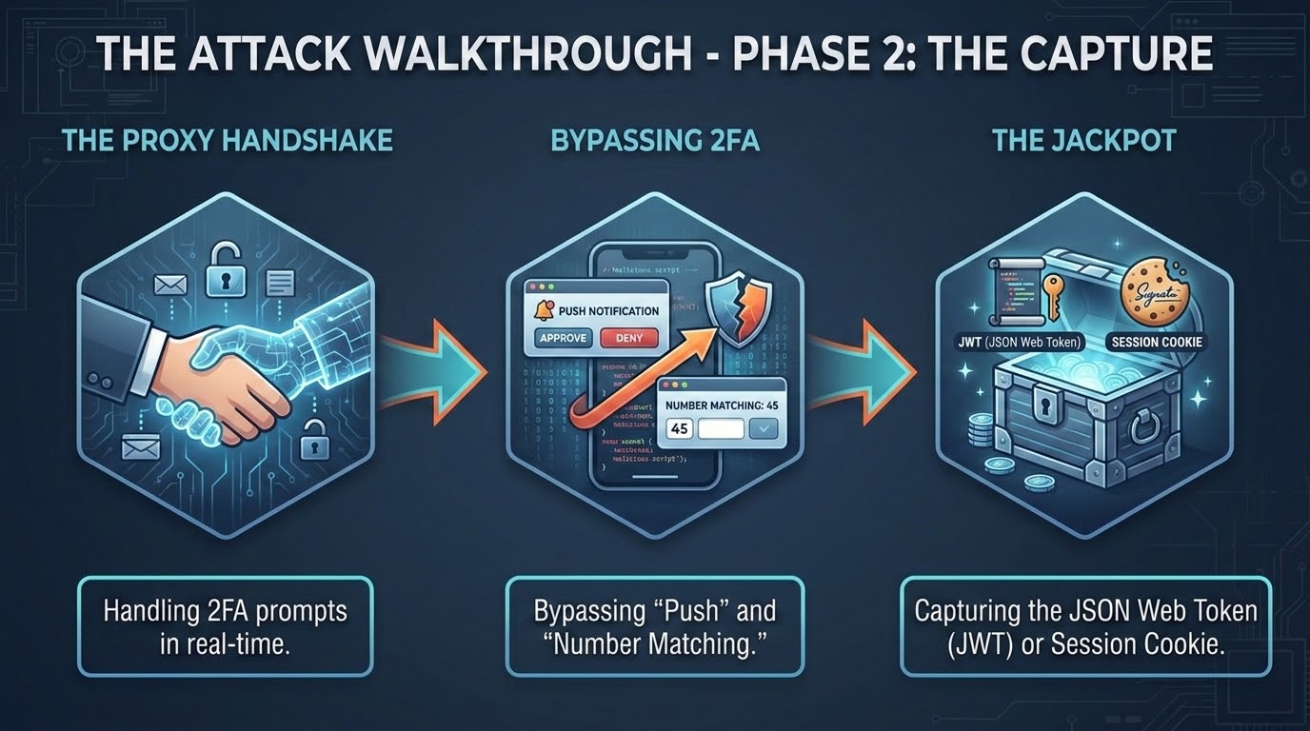
Notes:
Number Matching? No Problem: Explain that because the proxy is real-time, the user sees the number on the Evilginx site, looks at their phone, and enters it. It is perfectly proxied to the real service.
The Moment of Success: Describe the "Success Redirect." Once the cookie is captured, Evilginx redirects the user to the actual internal site. The user thinks they just had to log in twice—they have no idea they’ve been compromised.

Slide 7
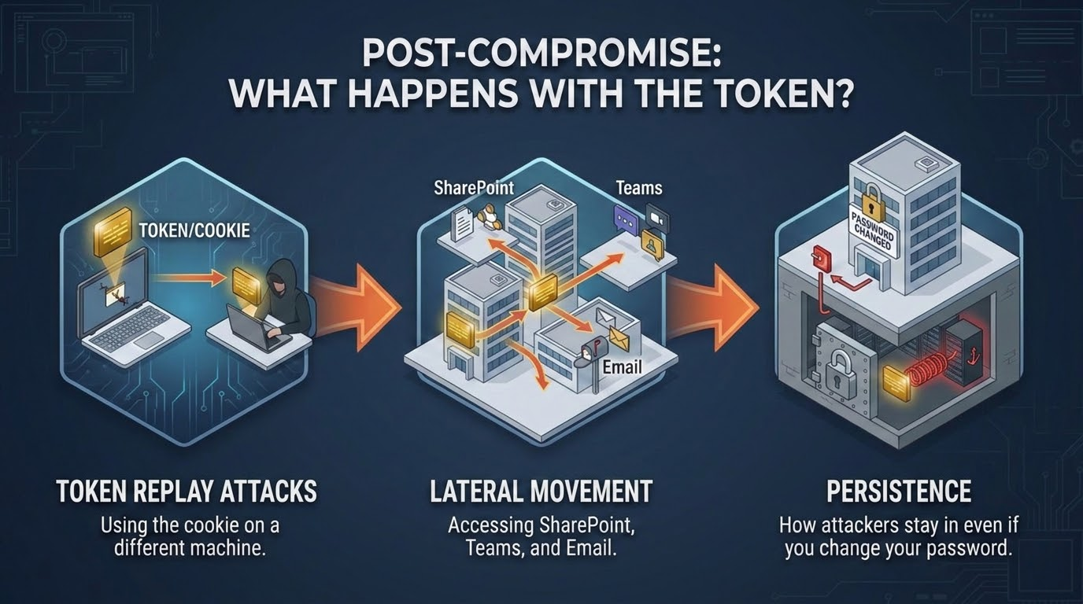
Notes:
The Bypass: The attacker takes that session cookie, imports it into their own browser, and is instantly logged in as the user. No password or MFA needed.
Persistence: Changing the password does not always invalidate existing session tokens. An attacker can often stay in for 8–24 hours, or longer if they can "refresh" the token.
API Access: Discuss how captured tokens are used to scrape data via Graph API or other internal APIs.

Slide 8
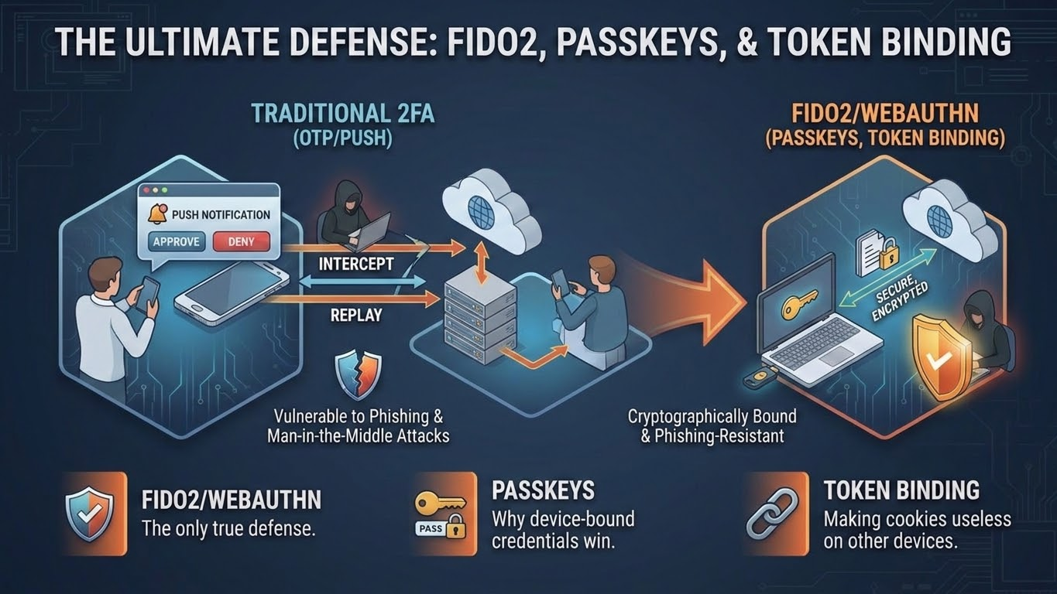
Notes:
Cryptographic Binding: Explain why FIDO2 (YubiKeys, Windows Hello) works. The browser and the hardware key negotiate directly with the origin (the real domain). If the domain is microsoft-login-evil.com, the hardware key simply refuses to sign the challenge.
The "Downgrade" Risk: Warn the audience that attackers will try to "downgrade" users. If FIDO fails, they'll prompt: "Security Key not recognized, use SMS instead?" This is where the human element must be trained.

Slide 9
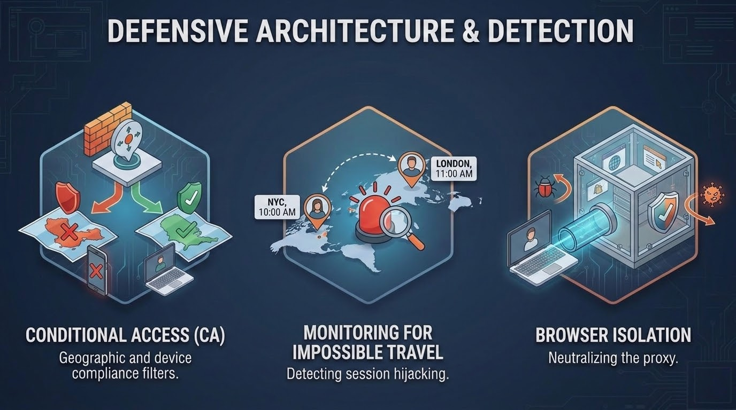
Notes:
Conditional Access: If a session token for a PA resident suddenly appears from a VPS in Germany, CA should kill it.
Detection: Mention monitoring for "New Device Registered" or "Token Replayed from New IP."
Managed Browsers: Discuss how forcing users through a managed browser or a VDI (Virtual Desktop) can prevent them from ever reaching an external proxy.

Slide 10
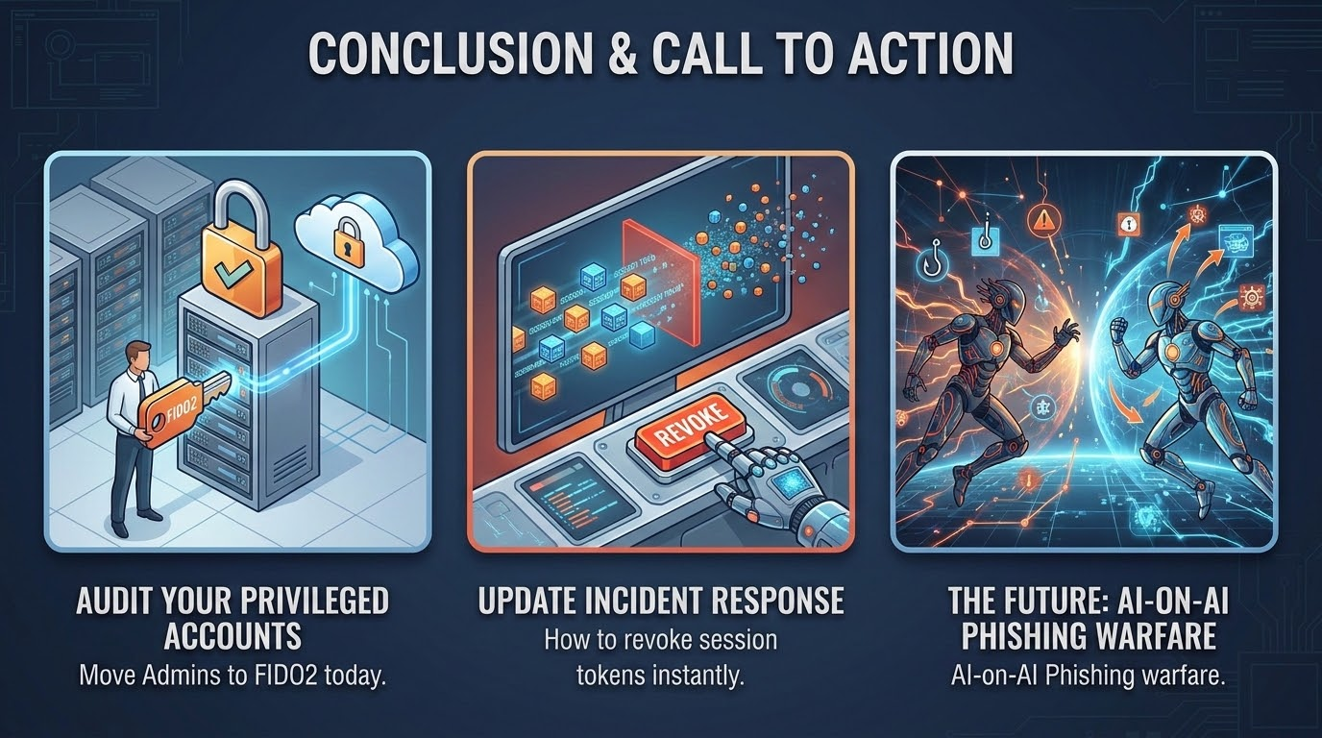
Notes:
Your IT admins and C-suite need hardware keys today. They are the "Whaling" targets for Evilginx.
Final Thought: We can't stop users from clicking, but we can make the click meaningless by using phishing-resistant infrastructure.

Slide 11
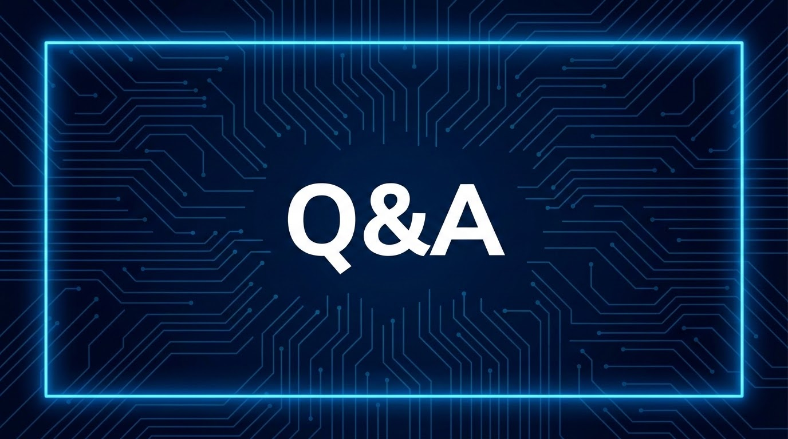

Notes:
Open for questions.
Be ready for: "How much does Evilginx Pro cost?", "Does this work on mobile?", and "How do I revoke tokens in Entra ID?"

